Slide 1
CSE 4802
Lab 3
Transformation Tools

Slide 2
Transformation Tools
Def: A transformation tool converts programs between different forms of representations, usually between text and graphics.
For example,
Transforming code to visual form and vice versa
Because of the impact that visual representations can have on comprehension, use of a transformation tool can help the maintainer view and understand the system in a way that would not be possible with only source code.

Slide 3
Loguru
Loguru is a library which aims to bring enjoyable logging in Python.
Github link: https://github.com/Delgan/loguru
Command to install: pip install loguru
Features:
One core object to handle every logging configuration and usage pass through to one of Logger’s method
One function to rule them all
Easier file logging
Exceptions catching within threads or main
Logging with colors
Fully descriptive exceptions

Slide 4
Loguru
To log a program with loguru, the only object needs to be exported is logger
Example:
from loguru import logger
Most used methods are:
logger.trace("A trace message.")
logger.debug("A debug message.")
logger.info("An info message.")
logger.success("A success message.")
logger.warning("A warning message.")
logger.error("An error message.")
logger.critical("A critical message.")

Slide 5
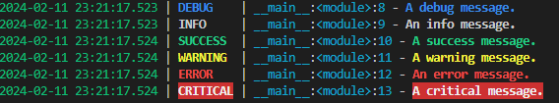
Loguru

Slide 6
Loguru
To add different labels, formatting and level to the logging output to any file, logger provides function called add()
Example:
logger.add("a.log", format="{time:MMMM D, YYYY > HH:mm:ss!UTC} | {level} | {message}")
For serialized logging:
logger.add("a.log", format="{time:MMMM D, YYYY > HH:mm:ss!UTC} | {level} | {message}", serialize=True)
Loguru always log with all variables changing values, but for sensitive information,
logger.add("a.log", format="{time:MMMM D, YYYY > HH:mm:ss!UTC} | {level} | {message}", diagnose=False)

Slide 7
Loguru
To add extra information or contextualize the logging information,
logger.add(sys.stderr, format="{time:MMMM D, YYYY > HH:mm:ss} | {level} | {message} | {extra}")
@logger.contextualize(seller_id="001", product_id="123")
def log():
logger.info("A user requested a service.")
log()
logger = logger.bind(seller_id="001", product_id="123")
Output:
February 11, 2024 > 22:54:06 | INFO | A user requested a service. | {'seller_id': '001', 'product_id': '123'}

Slide 8
Loguru
To replace the try..catch block, it has @logger.catch() with it own formatting,
Example,
@logger.catch(level='CRITICAL',message="Not Good")
def func1(num1: int, num2: int):
return num1/num2
func1(2,0)

Slide 9
PySnooper
PySnooper is a poor man's debugger. It is a Python package that prints the lines of code being executed along with the values of each variable by adding only one decorator.
Github Link: https://github.com/cool-RR/PySnooper
Install: pip install pysnooper

Slide 10
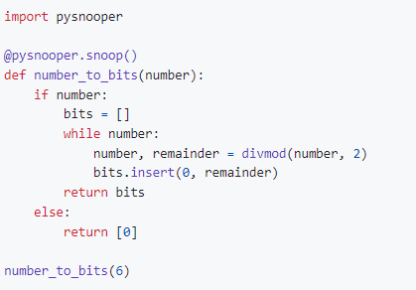
PySnooper

Slide 11
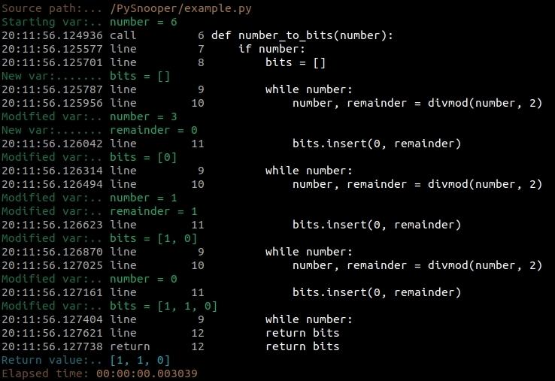
PySnooper

Slide 12
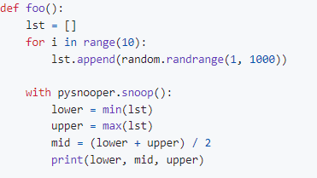
PySnooper
Pysnooper for specific portion

Slide 13
PySnooper
For logging the outputs in a file,
@pysnooper.snoop('/my/log/file.log')
For without all machine related data,
@pysnooper.snoop(normalize=True)
For multi-thread informations,
@pysnooper.snoop(thread_info=True)

Slide 14
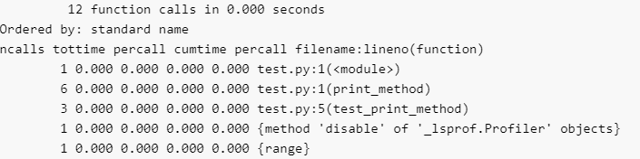
Profiling Tools
Code profiling is a method that is used to detect how long each function or line of code takes to run and how often it gets executed.
Most important package for python code profiling is called cProfile:
python -m cProfile test.py
Results can be seen in terminal like:

Slide 15
Viztracer
VizTracer is a tool to help you understand Python code by tracing and visualizing its execution. Without making any changes to your source code.
Command to install: pip install viztracer
Website link: https://github.com/gaogaotiantian/viztracer

Slide 16
Viztracer
def factorial(x):
if x == 1:
return 1
else:
return (x * factorial(x-1))
num = 7
result = factorial(num)
print("The factorial of", num, "is", result)
Command in terminal:
viztracer -o result.html --open my_script.py

Slide 17
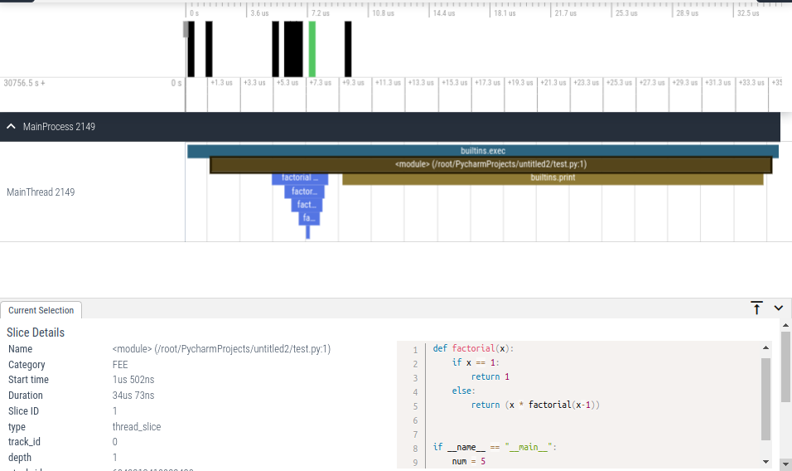

Slide 18
SnakeViz
SnakeViz is a browser based visualization tool. It needs the output in a .profile format.
Install the package:
pip install snakeviz --user
To Generate the output, two steps to follow:
Generate .profile file:
python -m cProfile -o <output_file>.profile <your_file>.py
Visualize profiling information:
snakeviz <output_file>.profile

Slide 19
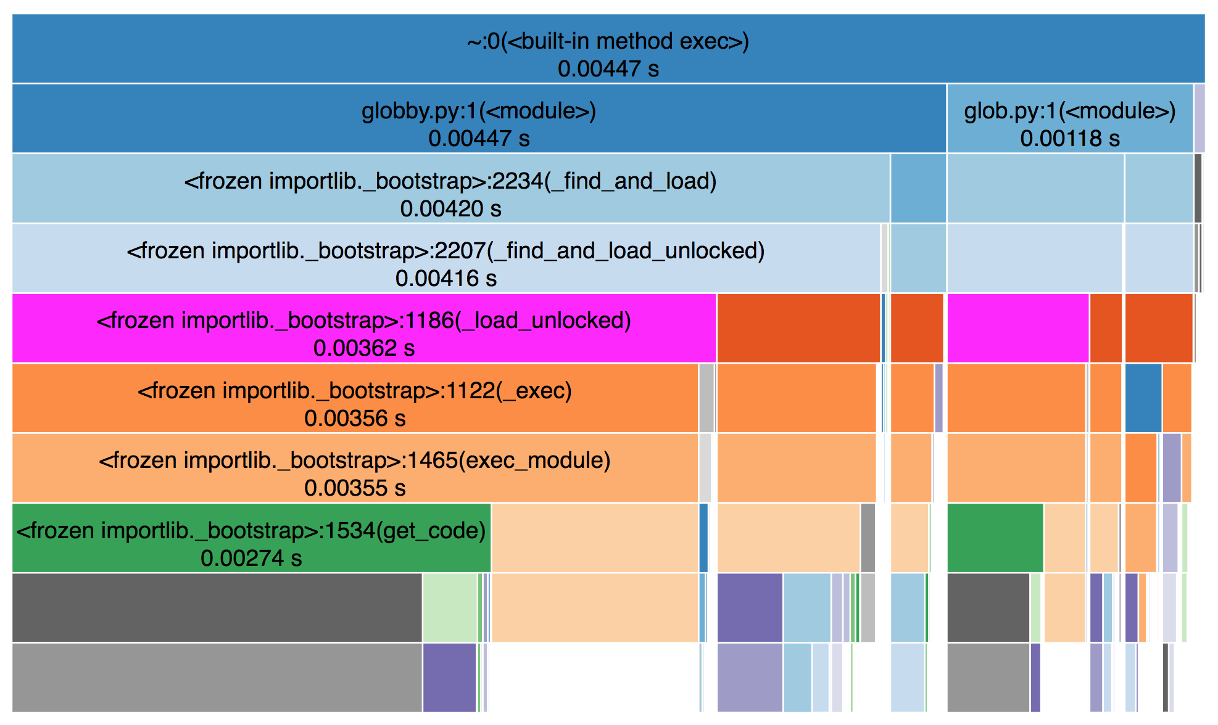
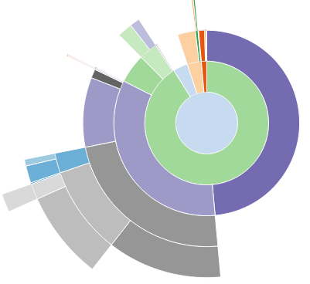
SnakeViz
Icicle Chart:
Sunburst Chart:

